Slide 1
School of Geography and Geology
McMaster University
Advanced Topics in Spatial Statistics
Spatially Continuous Data
V & VI

Slide 2
This session
Trend surface analysis
Generalized least squares
Spatial prediction
Kriging

Slide 3
Modeling Spatially Continuous Data
Trend Surface Analysis
  A method to model the first order component of a spatial process
  Multiple regression analysis using the coordinates of the points as “explanatory” variables

Slide 4
Example
Wolfcamp aquifer (Texas)
  High level nuclear waste depository (U.S.)
  Candidate locations: Texas, Washington state, Nevada
  68,000 waste canisters placed underground, surrounded by salt
  Covering an area of about 2 square miles
  US Department of Energy stipulates that canisters must be isolated by 10,000 years

Slide 5
Example: Wolfcamp Aquifer
Wolfcamp aquifer (Texas)
  Potential issues
    Leaks
    Tiny quantities of water in the salt could migrate towards the canisters
    Salt+water → hydrocloric acid could corrode canisters
    Contamination of aquifer

Slide 6
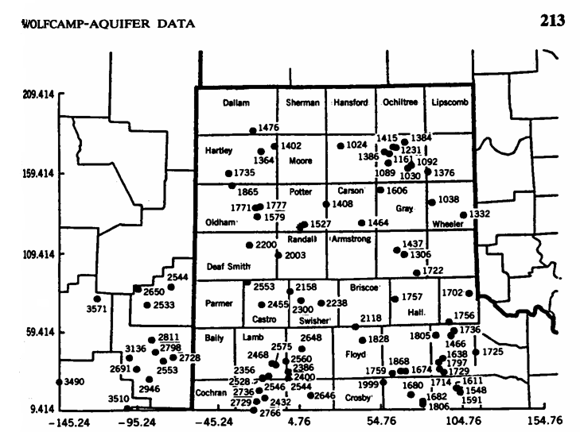
Example: Wolfcamp Aquifer

Slide 7
Example: Wolfcamp Aquifer
Data
  Piezometric head at 85 locations in Texas panhandle (h)
Geostatistical problems
  Determine sites at risk
  Interpolate surface
  Quantify uncertainty (location of monitoring stations)

Slide 8
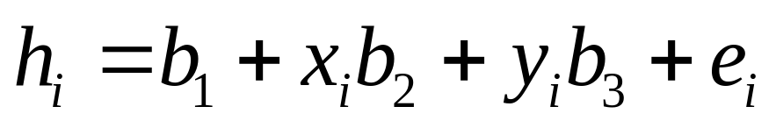
Example: Wolfcamp Aquifer
Spatial distribution of observations
Linear trend surface

Slide 9
Trend Surface Analysis
Quadratic trend surface
  h: head
  b₁ , b₂ ,…, b₆ : regression parameters
  x , y: coordinates of point I
Higher order polynomials
Cubic
  Quartic
  …

Slide 10
Trend Surface Analysis
Explanation vs. prediction?
Potential issues
  Multicolinearity
  Trend surfaces tend to “curl” around the edges
This example: fairly good fit
Notes:
However, check distribution of residuals

Slide 11
Spatial Prediction
Q: What are the implications of spatial structure for prediction?

Slide 12
Spatial Prediction
Error terms are not completely random, i.e., unpredictable
s₆
s₁
s_{p}
s₅
s₂
s₄
s₃

Slide 13
Spatial Independence
Error terms are completely random, i.e., unpredictable
s₆
s₁
s_{p}
s₅
s₂
s₄
s₃

Slide 14
Generalized Least Squares (GSL)
OLS
  Variance is constant
  Error terms are independent (i.e. random)

Slide 15
Generalized Least Squares
More general regression model
  Relaxes some of the assumptions imposed on the error terms
  Non-constant variance
  Spatial dependency (spatial structure)
Incorporate residual spatial structure

Slide 16
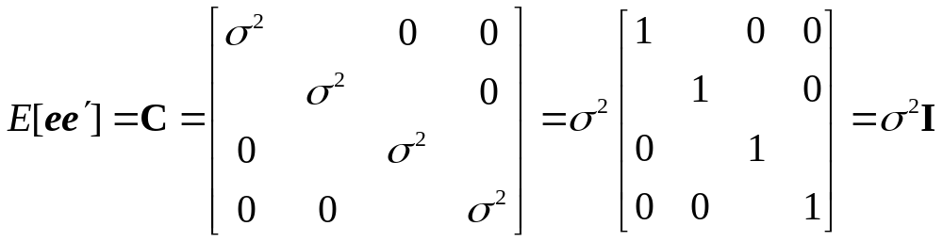
Regression Analysis
Error terms (Ordinary Least Squares)
  Constant variance
  Independent

Slide 17
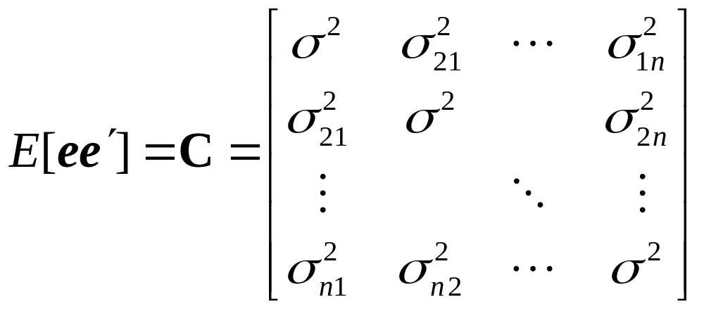
Regression Analysis
Error terms (Generalized Least Squares)
  Constant variance
  NOT Independent: covariance between e_{i} and e_{j} ≠ 0

Slide 18
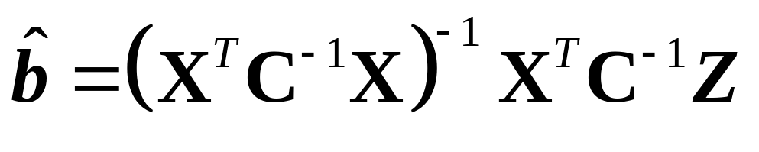
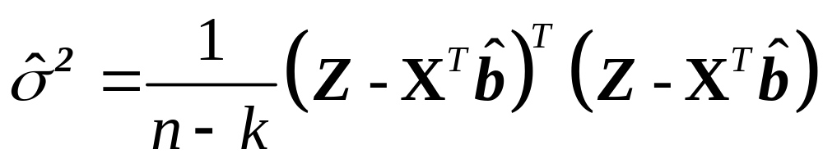
Regression Analysis: GSL
Parameters
Variance

Slide 19
Spatial Prediction
Kriging
  So called after South African mining geologist D.G. Krige
  Method for spatial prediction
  Makes use of autocorrelation information
  Optimal spatial prediction!

Slide 20
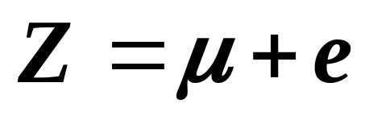
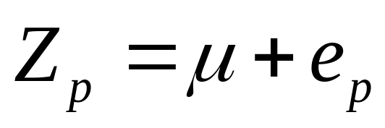
Simple Kriging
A method for optimal prediction when there is no trend (first order effects), or when the trend is known
Model with constant or known trend μ
Spatial prediction

Slide 21
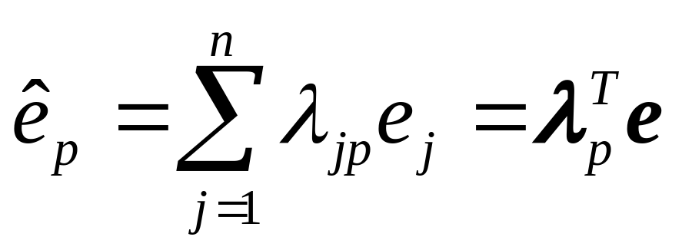
Simple Kriging
When errors are autocorrelated
s₆
s₁
s_{p}
λ_{jp}: linear weights
s₅
s₂
s₄
s₃

Slide 22
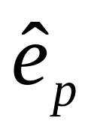
Simple Kriging
is a random variable
  Expected (mean) value = 0
  How close (on average) is it to e?

Slide 23
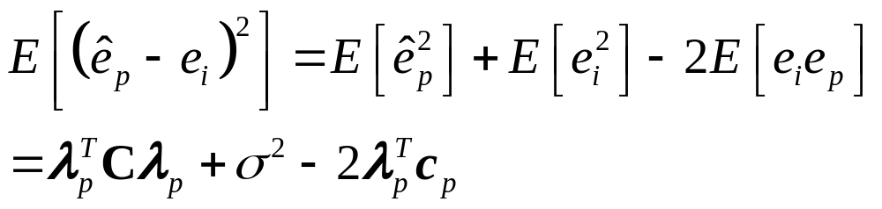
Simple Kriging
How close (on average) is to e?
  Expected mean square error (prediction variance):
C: covariance matrix
c_{p}: covariance vector between e and

Slide 24
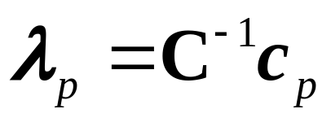
Simple Kriging
Minimizing the expected mean square error gives weight λ:
C: covariance matrix
c_{p}: covariance vector between e and

Slide 25
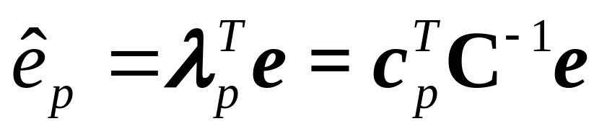
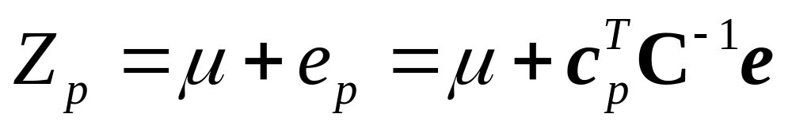
Simple Kriging
This leads to:
Which can be added to the known mean to give:

Slide 26
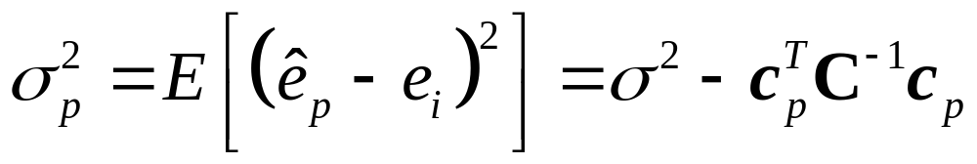
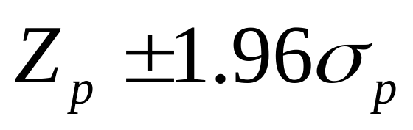
Simple Kriging
Prediction variance:
Interval of confidence for prediction (95% level of confidence):

Slide 27
Simple Kriging
Limitations
  Trend is not always constant or known
  Covariance structure is not known

Slide 28
Defining Spatial Structure
Variogram ← → Covariance
Generalized Least Squares
  Parameter estimation
  Inference
Spatial prediction
  Simple kriging
  Generalized spatial prediction
  Ordinary and universal kriging
Notes:
Errors not random: implications for parameter estimation and inference
Errors not completely unpredictable: additional information can be used for spatial prediction

Slide 29
Simple Kriging
Example: Walker Lake data
  Very weak trend – no trend
  Linear trend: R²=0.063
  Quadratic trend: R²=0.126
  Cubic trend: R²=0.172
Perfect application of simple kriging
  “Known” trend: mean

Slide 30
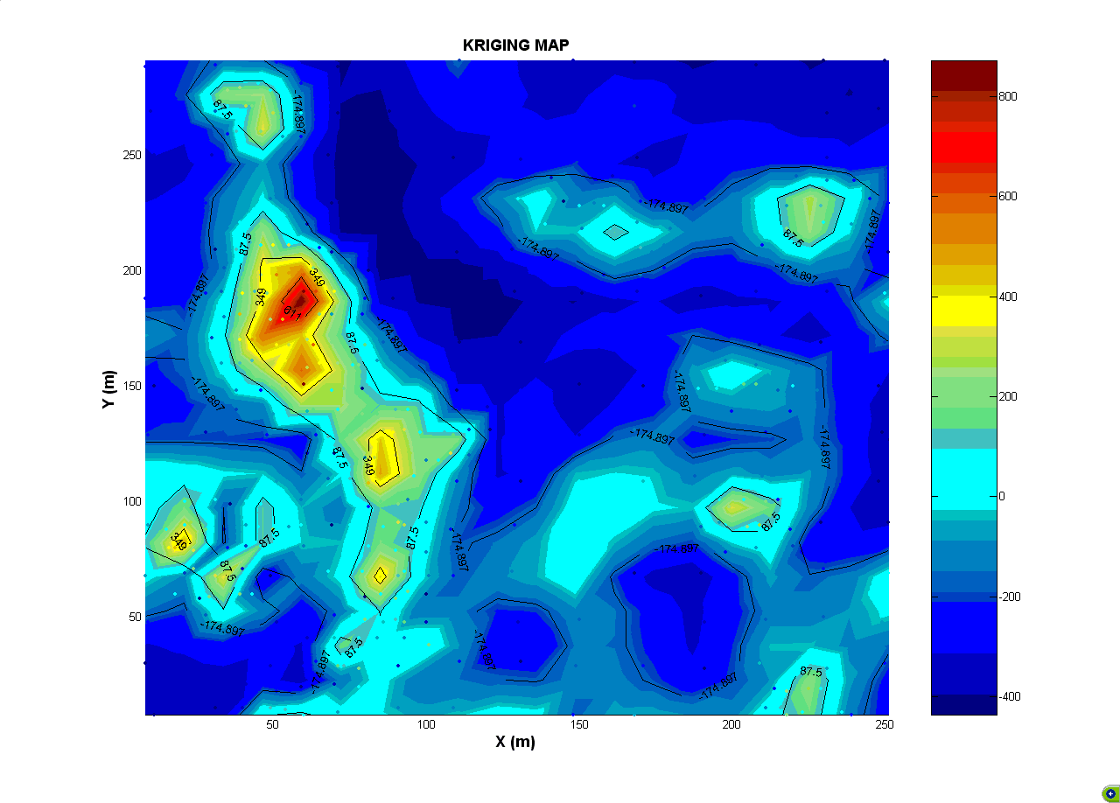
Example: Kriging Map (Exponential)

Slide 31
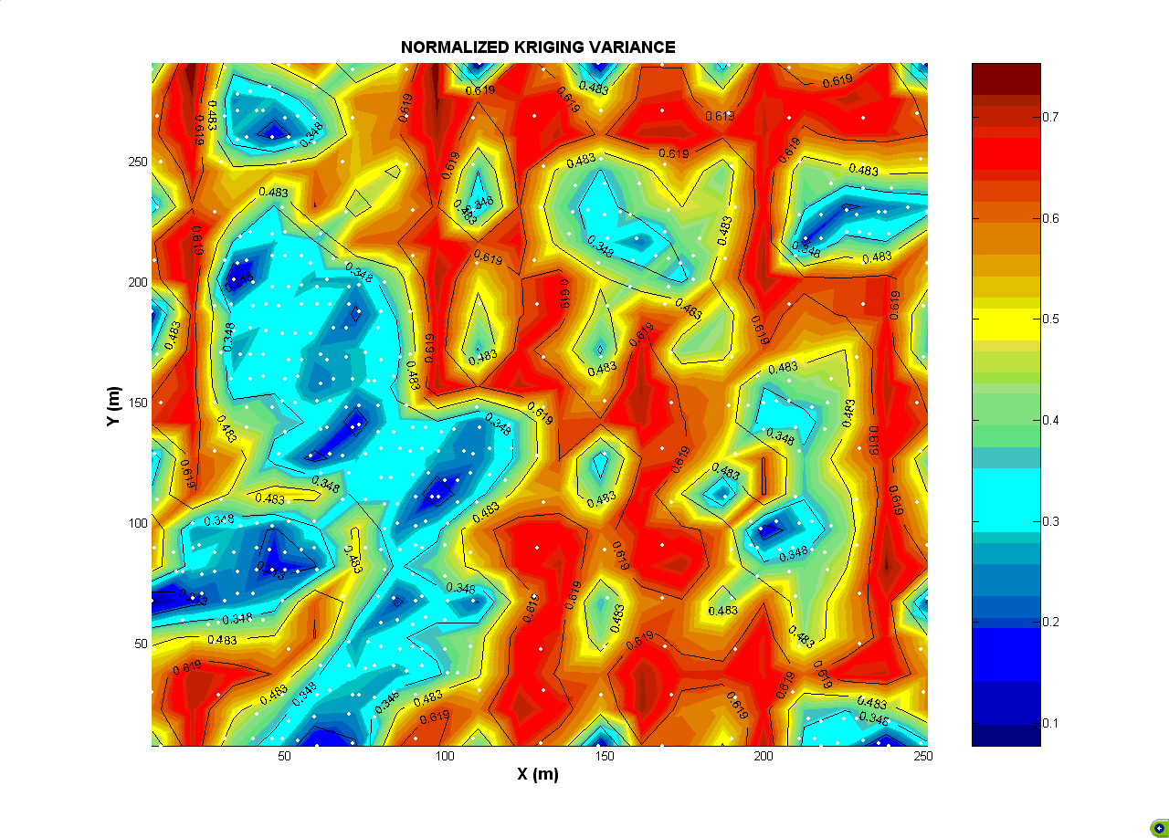
Example: Kriging Variance
(Exponential)

Slide 32
General Spatial Prediction
In simple kriging there is no trend or the trend is known
  Example: Walker Lake dataset
In many other cases there is a trend that must be estimated from the data

Slide 33
General Spatial Prediction
Evidence of a trend
  Trend surface analysis
  Empirical variogram (absolute values or deviation from the mean)
Notes:
Use blackboard for example

Slide 34
General Spatial Prediction
Evidence of a trend
x10⁵
Empirical Variogram, Wolfcamp Aquifer
12
10
8
Gamma-hat
6
4
2
0
20
40
60
80
100
120
140
160
180
200
Lag h

Slide 35
General Spatial Prediction
It becomes necessary to estimate the trend
  Trend surface analysis
  Other covariates
  A combination of trend surface analysis and other covariates

Slide 36
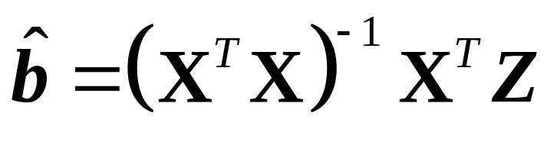
General Spatial Prediction
Modeler’s dilemma!
  The trend is estimated by OLS (We don’t know if there is autocorrelation!)
  However, if there is autocorrelation, the estimators should be:

Slide 37
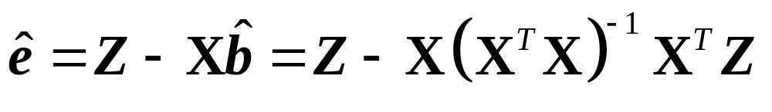
General Spatial Prediction
Iterative procedure:
  Step 1. Fit a trend surface model by OLS and obtain the residuals:
  Step 2. Describe spatial structure of residuals using a variogram and derive a covariance matrix C

Slide 38
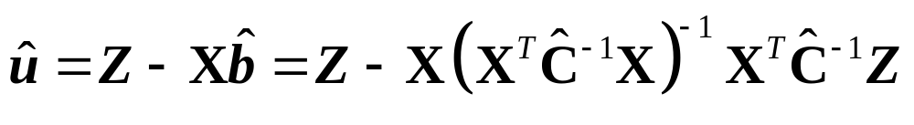
General Spatial Prediction
Iterative procedure:
  Step 3. Fit a trend surface model by GLS and obtain revised residuals:
  Step 4. Iterate steps 2 and 3 until stability of the parameters is achieved

Slide 39
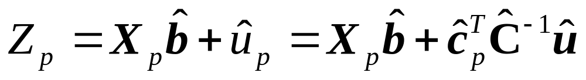
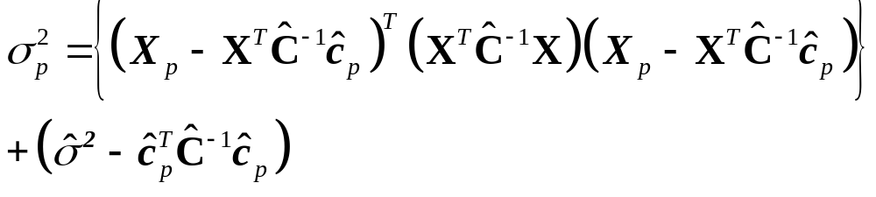
General Spatial Prediction
Iterative procedure:
  Step 5. Predict Z_{p} as:
  Step 6. Calculate the prediction variance:

Slide 40
General Spatial Prediction
Example: Wolfcamp Aquifer data
  Strong trend
  Linear trend: R²=0.892
  Quadratic trend: R²=0.913
  Cubic trend: R²=0.923
General spatial prediction
  Use trend surface

Slide 41
Variogram Selection
What is the best variogram for my application?
Variogram selection
Notes:
This works for very, very large datasets.

Slide 42
Variogram Selection
Validation sample
  Use a sub-sample of data for model estimation
  Use model to predict those observations not used for estimation
Notes:
This works for very, very large datasets.

Slide 43
Variogram Selection
Cross-validation
  Double kriging
Notes:
This works for very, very large datasets.

Slide 44
Variogram Selection
Double kriging
Notes:
This works for very, very large datasets.

Slide 45
Variogram Selection
Cross-validation
  Leave-one-out
Notes:
This works for very, very large datasets.

Slide 46
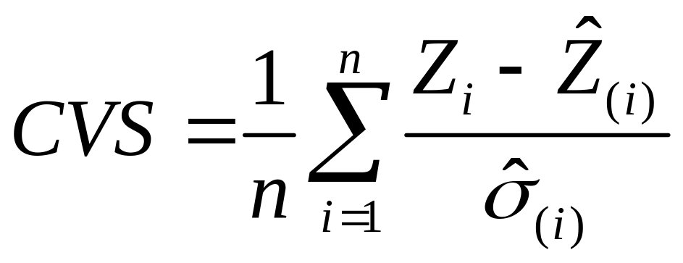

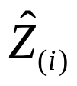
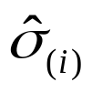
Variogram Selection
Cross-validation scores
  : observed value at location i
  : predicted value after removing observation at i
  : standard error estimated after removing observation i

Slide 47
Variogram Selection
Theoretical soundness
  What do we know about the generating process?
Notes:
Example: pollution, particles of different sizes, lumps are depose unequally or are dispersed.
Magnetic fields are super continuous

Slide 48
Variogram Selection
Cross-validation
  Accuracy
Prediction (kriging) variance
  Precision

Slide 49
Variogram Selection
Precise…inaccurate
Notes:
This works for very, very large datasets.

Slide 50
Variogram Selection
Accurate…imprecise
Notes:
This works for very, very large datasets.

Slide 51
Variogram Selection
Accurate…precise
Notes:
This works for very, very large datasets.

Slide 52
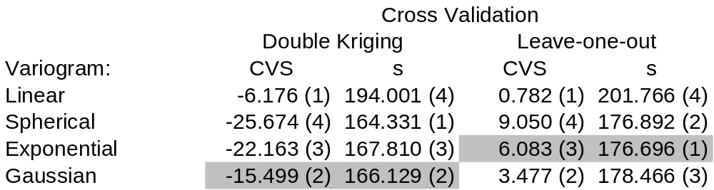
Example
Variogram Selection: Wolfcamp Aquifer
  Linear trend

Slide 53
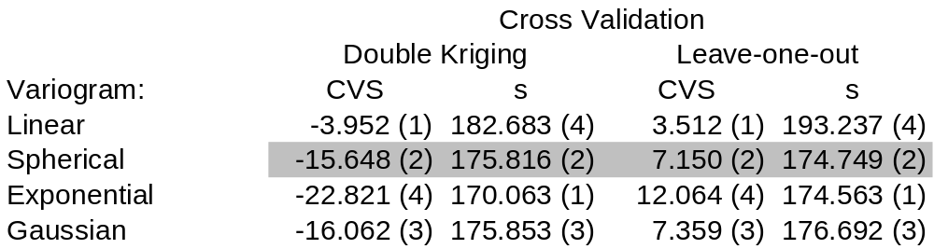
Example
Variogram Selection: Wolfcamp Aquifer
  Quadratic trend

Slide 54
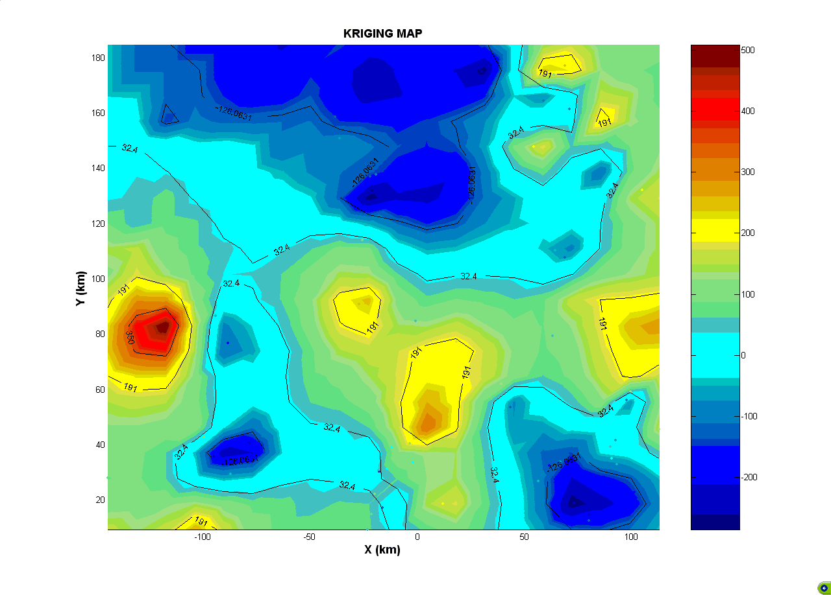
Example: Kriging Map (Exponential)

Slide 55
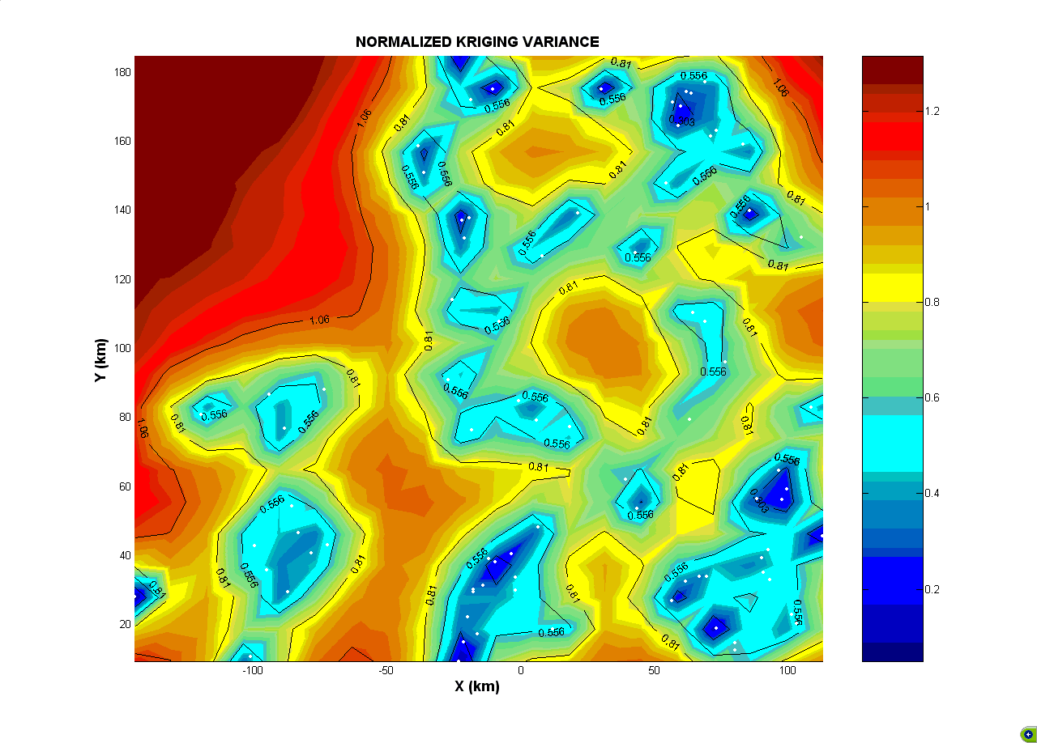
Example: Kriging Variance
(Exponential)

Slide 56
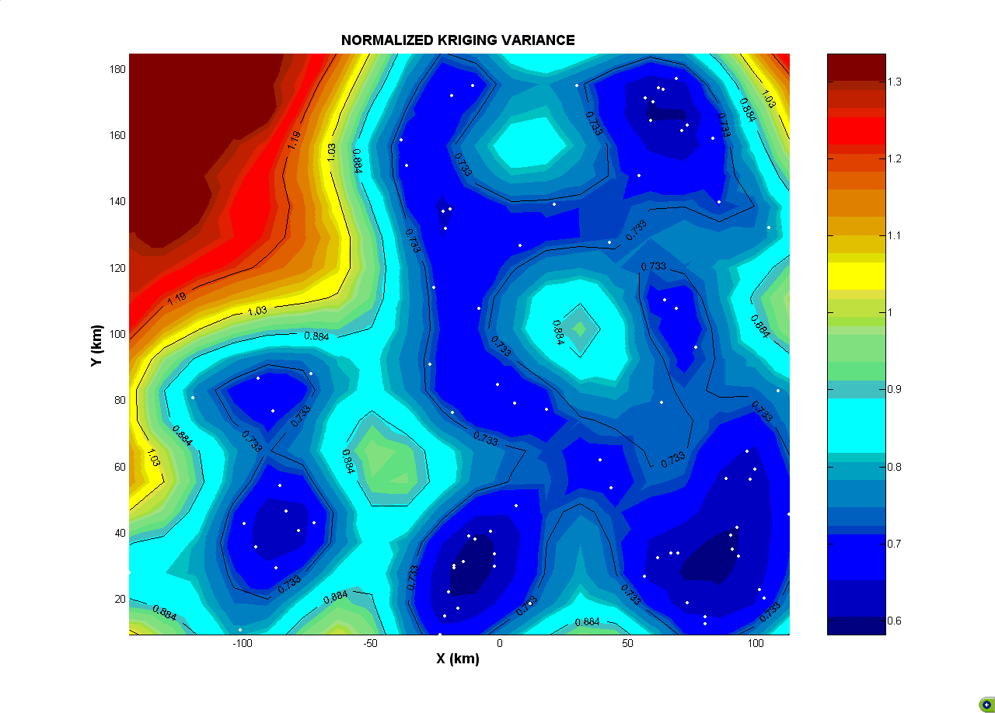
Example: Kriging Variance
(Gaussian)

Slide 57
Ordinary and Universal Kriging
Mathematically equivalent to simple kriging and general spatial prediction
  Simple kriging = ordinary kriging
  Universal kriging = general spatial prediction
Different emphasis: purely predictive methods

Slide 58
Ordinary and Universal Kriging
Take a “one-step” approach with the trend implicit in the prediction process
  Not so relevant in the case of simple kriging
  May simplify the process in the case of processes with a trend
  Although it is possible to retrieve the trend, Bailey and Gatrell recommend explicitly modeling it by using general spatial prediction

Slide 59
Next
The End

